Slide 1

DATA STRUCTURES AND ALGORITHMS (113215)
Dr. Owais Hussain

Slide 2

Agenda
Algorithmic Notations
Infix Notations
Polish Notations
Postfix Notations
Infix to Postfix Conversion
Postfix Equation Evaluation

Slide 3
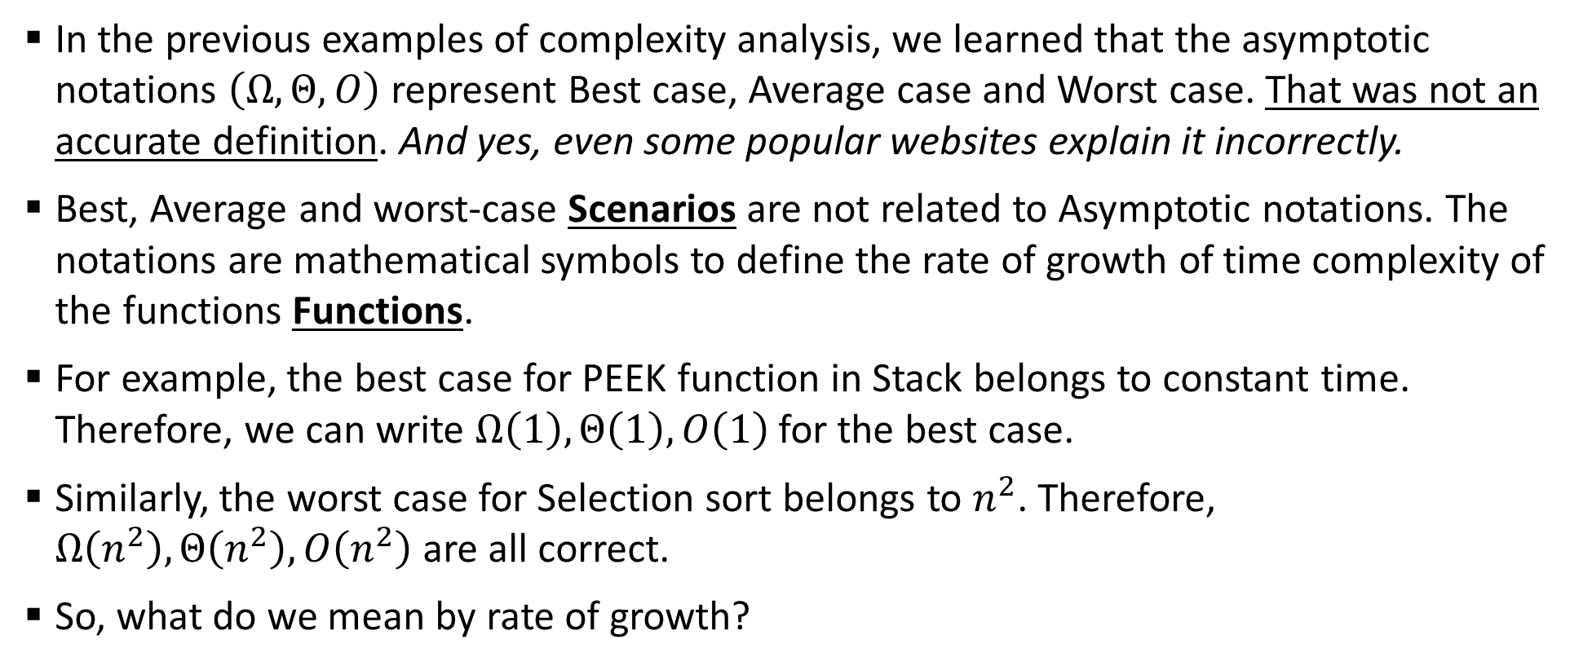
Sample 2
Algorithmic Notations
In the previous examples of complexity analysis, we learned that the asymptotic notations $\left(Ω,Θ,O\right)$ represent Best case, Average case and Worst case. That was not an accurate definition. And yes, even some popular websites explain it incorrectly.
Best, Average and worst-case Scenarios are not related to Asymptotic notations. The notations are mathematical symbols to define the rate of growth of time complexity of the functions Functions.
For example, the best case for PEEK function in Stack belongs to constant time. Therefore, we can write $Ω\left(1\right),Θ\left(1\right),O\left(1\right)$ for the best case.
Similarly, the worst case for Selection sort belongs to $n^{2}$. Therefore, $Ω\left(n^{2}\right),Θ\left(n^{2}\right),O\left(n^{2}\right)$ are all correct.
So, what do we mean by rate of growth?

Slide 4
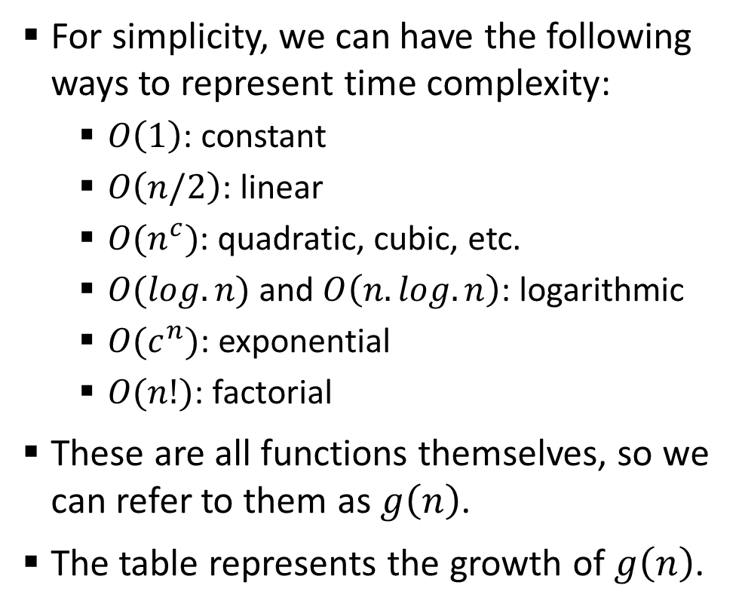
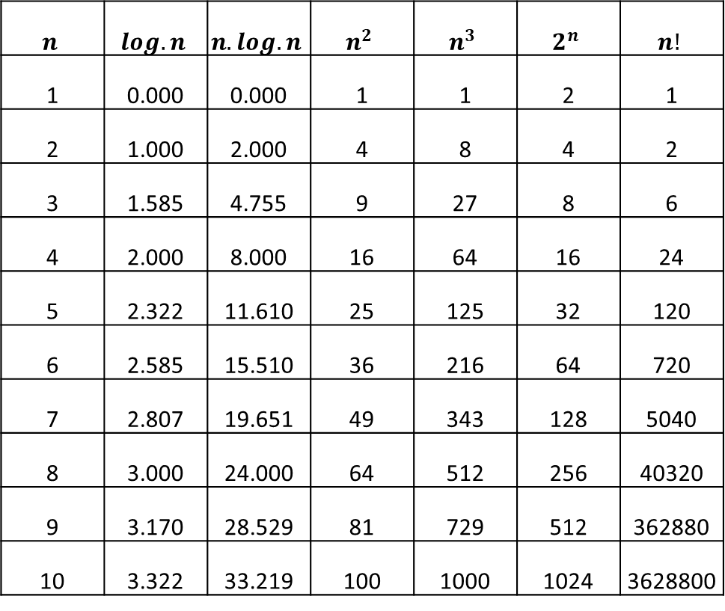
Sample 2
Algorithmic Notations
For simplicity, we can have the following ways to represent time complexity:
$O\left(1\right)$: constant
$O\left(n/2\right)$: linear
$O(n^{c})$: quadratic, cubic, etc.
$O(log.n)$ and $O\left(n.log.n\right)$: logarithmic
$O(c^{n})$: exponential
$O(n!)$: factorial
These are all functions themselves, so we can refer to them as $g\left(n\right)$.
The table represents the growth of $g\left(n\right)$.
$$n$$ | $$log.n$$ | $$n.log.n$$ | $$n^{2}$$ | $$n^{3}$$ | $$2^{n}$$ | $$n!$$
1 | 0.000 | 0.000 | 1 | 1 | 2 | 1
2 | 1.000 | 2.000 | 4 | 8 | 4 | 2
3 | 1.585 | 4.755 | 9 | 27 | 8 | 6
4 | 2.000 | 8.000 | 16 | 64 | 16 | 24
5 | 2.322 | 11.610 | 25 | 125 | 32 | 120
6 | 2.585 | 15.510 | 36 | 216 | 64 | 720
7 | 2.807 | 19.651 | 49 | 343 | 128 | 5040
8 | 3.000 | 24.000 | 64 | 512 | 256 | 40320
9 | 3.170 | 28.529 | 81 | 729 | 512 | 362880
10 | 3.322 | 33.219 | 100 | 1000 | 1024 | 3628800

Slide 5
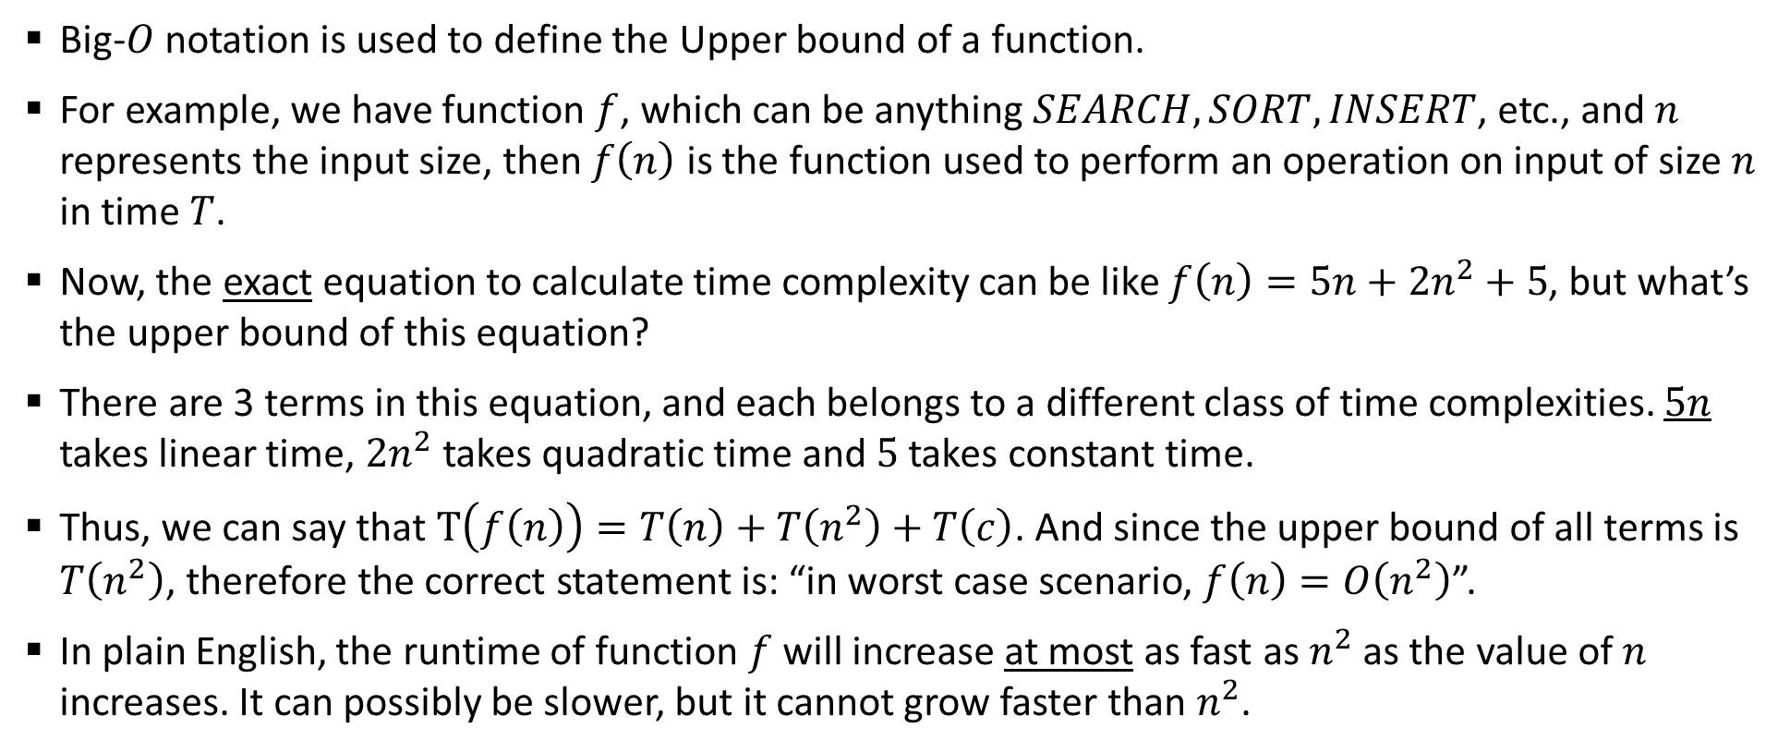
Sample 2
Algorithmic Notations
Big-$O$ notation is used to define the Upper bound of a function.
For example, we have function $f$, which can be anything $SEARCH,SORT,INSERT$, etc., and $n$ represents the input size, then $f\left(n\right)$ is the function used to perform an operation on input of size $n$ in time $T$.
Now, the exact equation to calculate time complexity can be like $f\left(n\right)=5n+{2n}^{2}+5$, but what’s the upper bound of this equation?
There are 3 terms in this equation, and each belongs to a different class of time complexities. $5n$ takes linear time, $2n^{2}$ takes quadratic time and $5$ takes constant time.
Thus, we can say that $T\left(f\left(n\right)\right)=T\left(n\right)+T\left(n^{2}\right)+T\left(c\right)$. And since the upper bound of all terms is $T\left(n^{2}\right)$, therefore the correct statement is: “in worst case scenario, $f\left(n\right)=O\left(n^{2}\right)$”.
In plain English, the runtime of function $f$ will increase at most as fast as $n^{2}$ as the value of $n$ increases. It can possibly be slower, but it cannot grow faster than $n^{2}$.

Slide 6
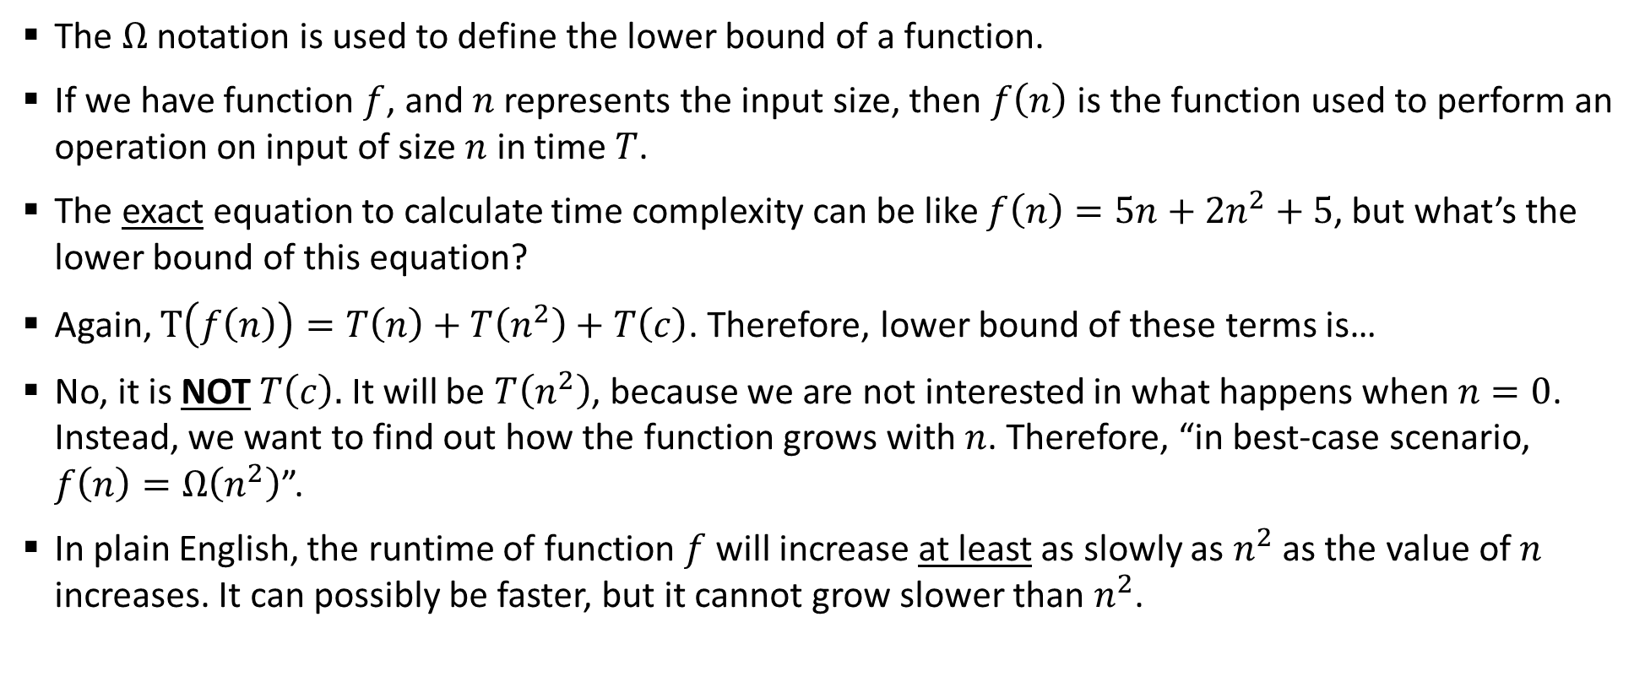
Sample 2
Algorithmic Notations
The $Ω$ notation is used to define the lower bound of a function.
If we have function $f$, and $n$ represents the input size, then $f\left(n\right)$ is the function used to perform an operation on input of size $n$ in time $T$.
The exact equation to calculate time complexity can be like $f\left(n\right)=5n+{2n}^{2}+5$, but what’s the lower bound of this equation?
Again, $T\left(f\left(n\right)\right)=T\left(n\right)+T\left(n^{2}\right)+T\left(c\right)$. Therefore, lower bound of these terms is…
No, it is NOT $T\left(c\right).$ It will be $T\left(n^{2}\right)$, because we are not interested in what happens when $n=0$. Instead, we want to find out how the function grows with $n$. Therefore, “in best-case scenario, $f\left(n\right)=Ω\left(n^{2}\right)$”.
In plain English, the runtime of function $f$ will increase at least as slowly as $n^{2}$ as the value of $n$ increases. It can possibly be faster, but it cannot grow slower than $n^{2}$.

Slide 7
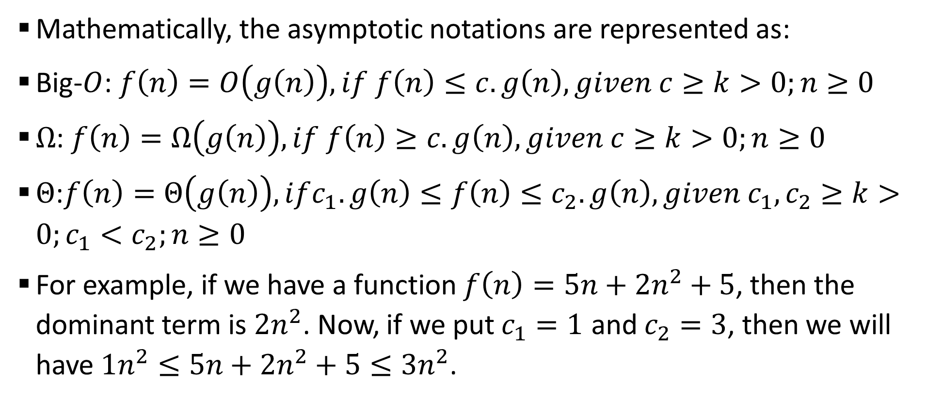
Sample 2
Algorithmic Notations
Mathematically, the asymptotic notations are represented as:
Big-$O$: $f\left(n\right)=O\left(g\left(n\right)\right), if f\left(n\right)≤c.g\left(n\right), given c≥k>0;n≥0$
$Ω$: $f\left(n\right)=Ω\left(g\left(n\right)\right),if f\left(n\right)≥c.g\left(n\right), given c≥k>0;n≥0$
$Θ$:$f\left(n\right)=Θ\left(g\left(n\right)\right),ifc_{1}.g\left(n\right)≤f\left(n\right)≤c_{2}.g\left(n\right), given c_{1},c_{2}≥k>0;c_{1}<c_{2};n≥0$
For example, if we have a function $f\left(n\right)=5n+{2n}^{2}+5$, then the dominant term is ${2n}^{2}$. Now, if we put $c_{1}=1$ and $c_{2}=3$, then we will have $1n^{2}≤5n+2n^{2}+5≤3n^{2}$.

Slide 8
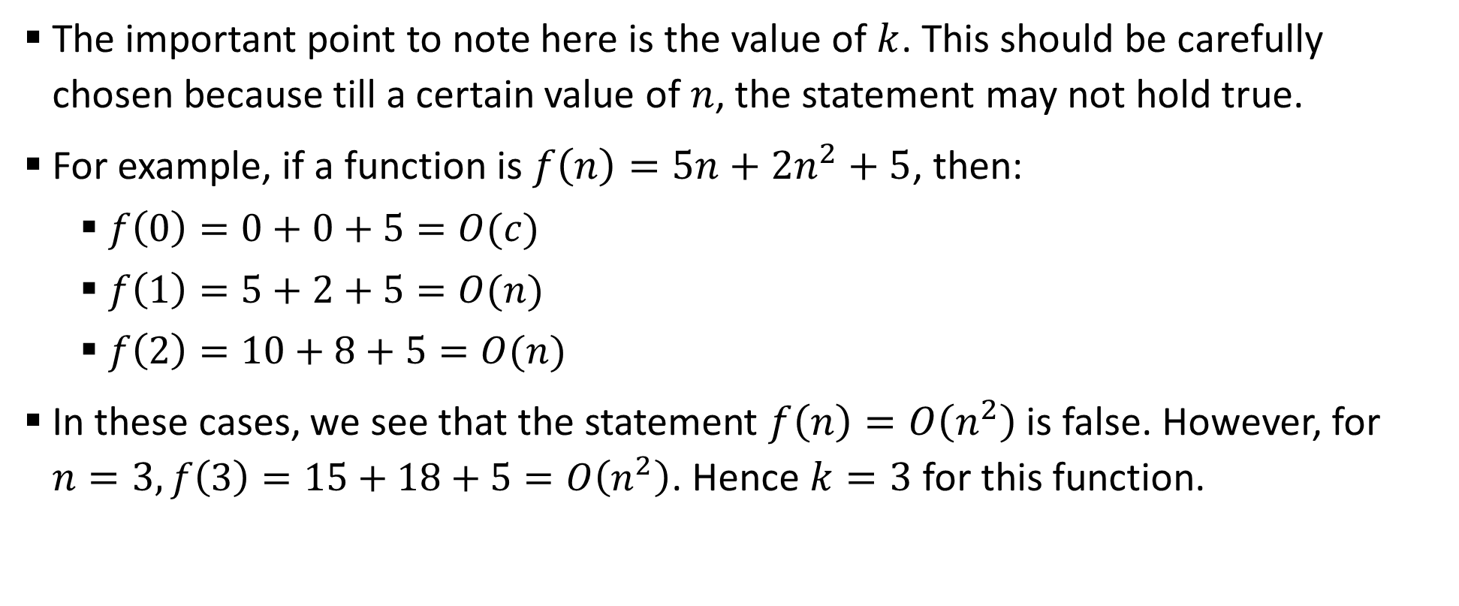
Sample 2
Algorithmic Notations
The important point to note here is the value of $k$. This should be carefully chosen because till a certain value of $n$, the statement may not hold true.
For example, if a function is $f\left(n\right)=5n+2n^{2}+5$, then:
$f\left(0\right)=0+0+5=O(c)$
$f\left(1\right)=5+2+5=O(n)$
$f\left(2\right)=10+8+5=O(n)$
In these cases, we see that the statement $f\left(n\right)=O\left(n^{2}\right)$ is false. However, for $n=3, f\left(3\right)=15+18+5=O\left(n^{2}\right)$. Hence $k=3$ for this function.

Slide 9
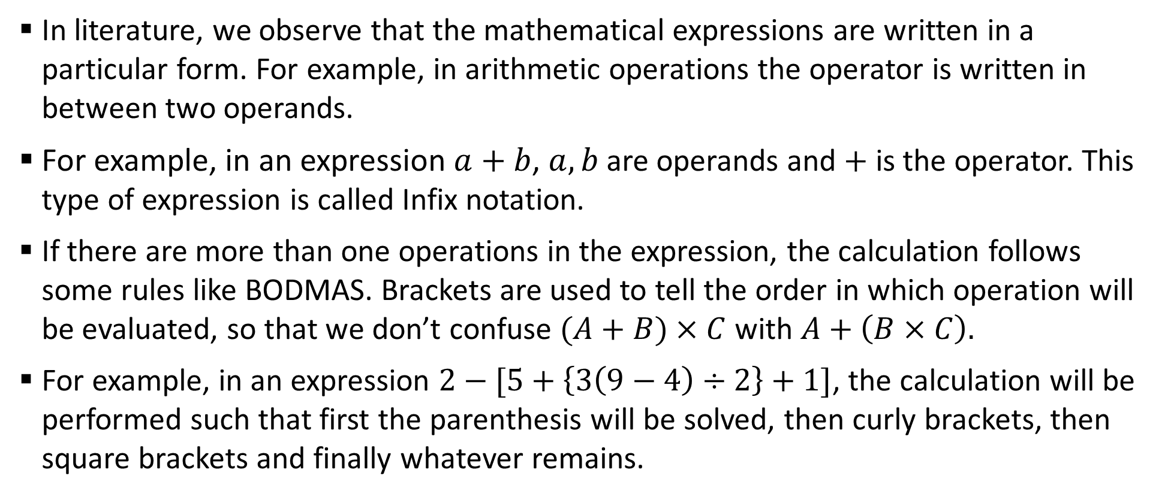
Sample 2
Infix Notations
In literature, we observe that the mathematical expressions are written in a particular form. For example, in arithmetic operations the operator is written in between two operands.
For example, in an expression $a+b$, $a,b$ are operands and $+$ is the operator. This type of expression is called Infix notation.
If there are more than one operations in the expression, the calculation follows some rules like BODMAS. Brackets are used to tell the order in which operation will be evaluated, so that we don’t confuse $(A+B)×C$ with $A+\left(B×C\right).$
For example, in an expression $2−[5+\left\{3\left(9−4\right)÷2\right\}+1]$, the calculation will be performed such that first the parenthesis will be solved, then curly brackets, then square brackets and finally whatever remains.

Slide 10
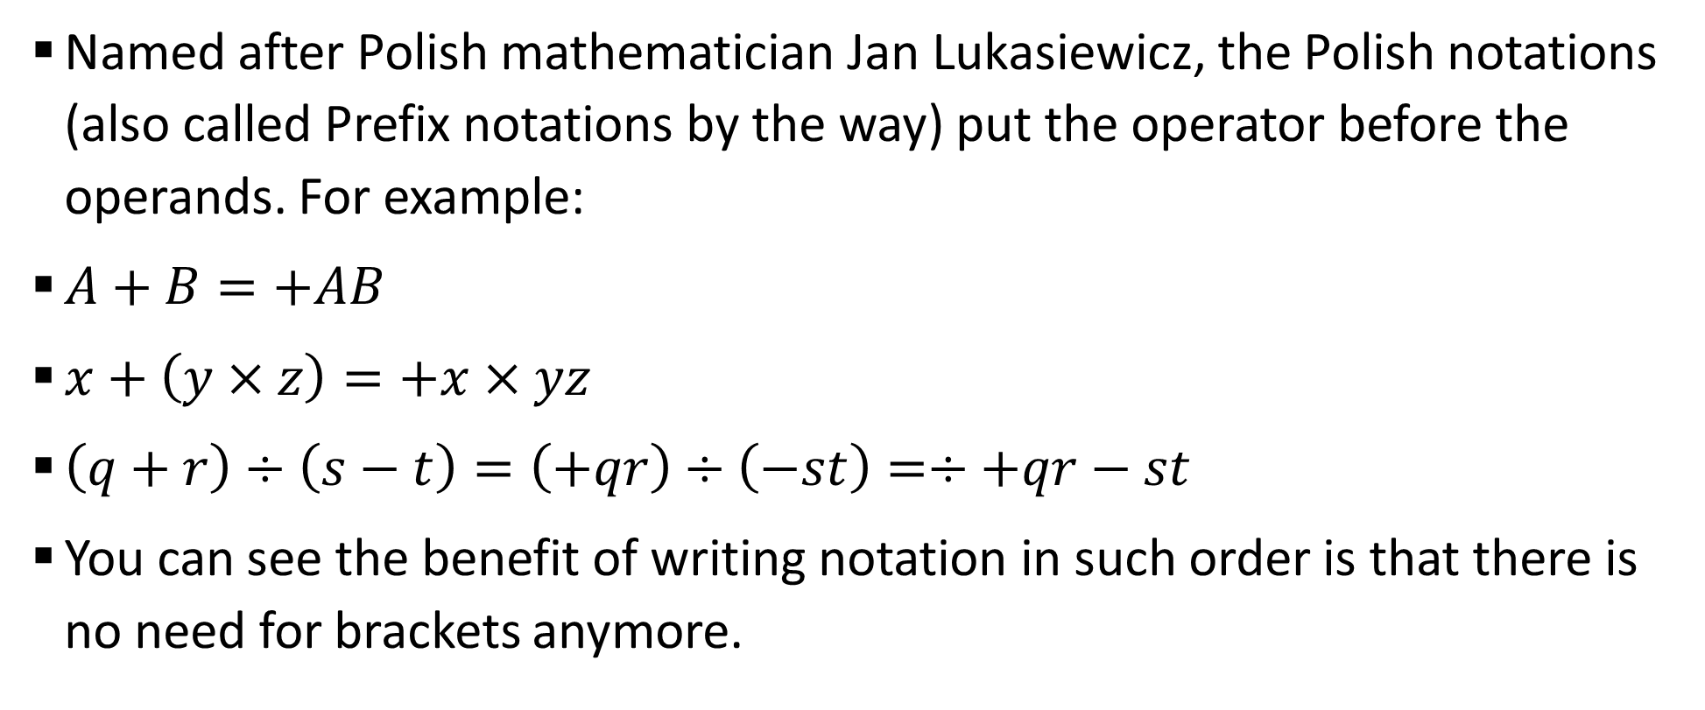
Sample 2
Polish Notations
Named after Polish mathematician Jan Lukasiewicz, the Polish notations (also called Prefix notations by the way) put the operator before the operands. For example:
$A+B=+AB$
$x+\left(y×z\right)=+x×yz$
$\left(q+r\right)÷\left(s−t\right)=\left(+qr\right)÷\left(−st\right)=÷+qr−st$
You can see the benefit of writing notation in such order is that there is no need for brackets anymore.
Notes:
Jan Lukasiewicz is pronounced as Woo-kah-shevich

Slide 11
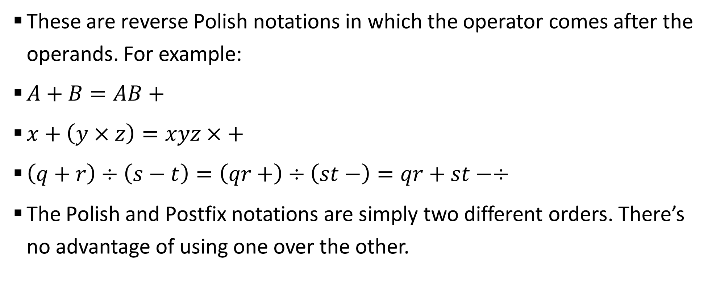
Sample 2
Postfix Notations
These are reverse Polish notations in which the operator comes after the operands. For example:
$A+B=AB+$
$x+\left(y×z\right)=xyz×+$
$\left(q+r\right)÷\left(s−t\right)=\left(qr+\right)÷\left(st−\right)=qr+st−÷$
The Polish and Postfix notations are simply two different orders. There’s no advantage of using one over the other.

Slide 12
Sample 2
Notation Conversion
Any program which evaluates a mathematical equation can be effectively stored in Polish or Postfix form and solved in left to right or right to left order.
In general, computers use Postfix notations and solve an equation in two steps:
An input Infix equation is converted in Postfix notation.
Postfix notation is evaluated.
Let’s see how we can write algorithms for this conversion and evaluation.

Slide 13
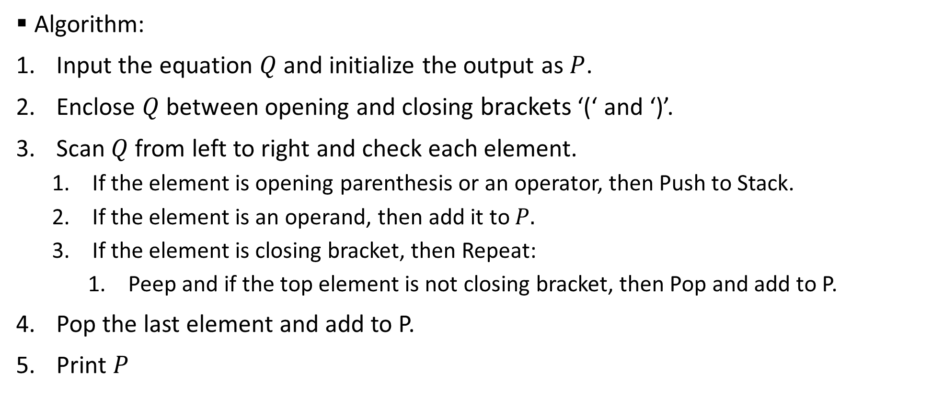
Sample 2
Notation Conversion
Algorithm:
Input the equation $Q$ and initialize the output as $P$.
Enclose $Q$ between opening and closing brackets ‘(‘ and ‘)’.
Scan $Q$ from left to right and check each element.
If the element is opening parenthesis or an operator, then Push to Stack.
If the element is an operand, then add it to $P.$
If the element is closing bracket, then Repeat:
Peep and if the top element is not closing bracket, then Pop and add to P.
Pop the last element and add to P.
Print $P$

Slide 14
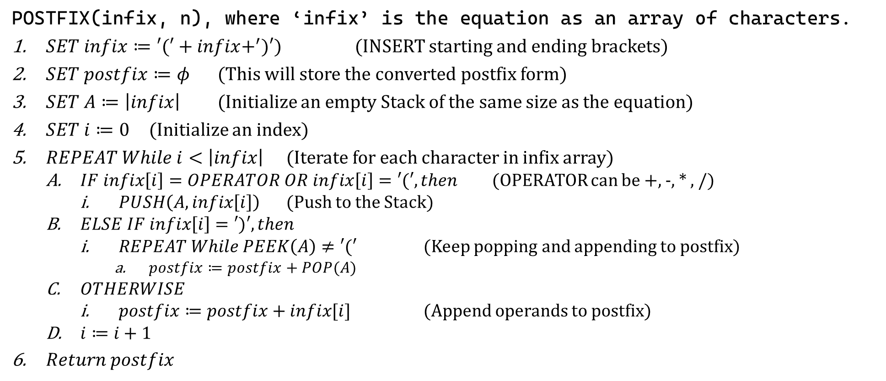
Sample 2
Notation Conversion
POSTFIX(infix, n), where ‘infix’ is the equation as an array of characters.
$SET infix≔′(′+infix+^{′})′)$ (INSERT starting and ending brackets)
$SET postfix≔φ$ (This will store the converted postfix form)
$SET A≔\left|infix\right|$ (Initialize an empty Stack of the same size as the equation)
$SET i≔0$ (Initialize an index)
$REPEAT While i<\left|infix\right|$ (Iterate for each character in infix array)
$IF infix\left[i\right]=OPERATOR OR infix\left[i\right]=′(′, then$ (OPERATOR can be +, -, * , /)
$PUSH\left(A, infix\left[i\right]\right)$ (Push to the Stack)
$ELSE IF infix\left[i\right]=′)′, then$
$REPEAT While PEEK\left(A\right)≠′(′$ (Keep popping and appending to postfix)
$postfix≔postfix+POP(A)$
$OTHERWISE$
$postfix≔postfix+infix[i]$ (Append operands to postfix)
$i≔i+1$
$Return postfix$

Slide 15
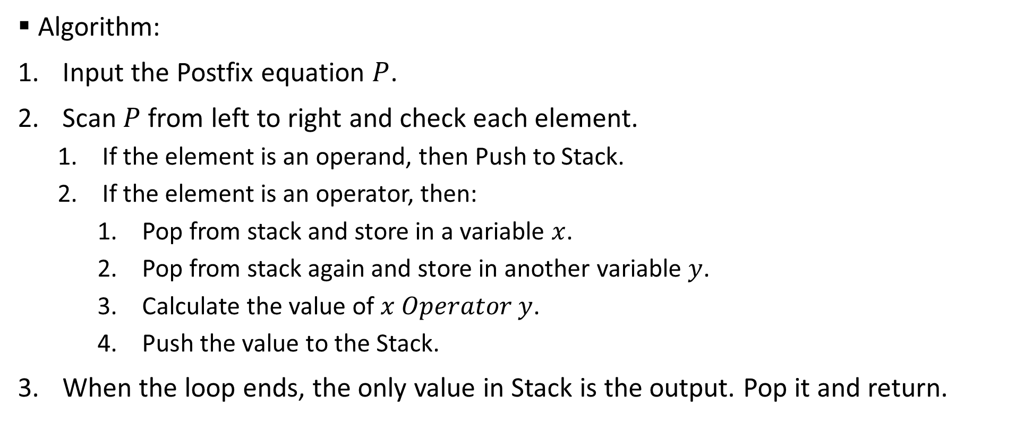
Sample 2
Postfix Evaluation
Algorithm:
Input the Postfix equation $P$.
Scan $P$ from left to right and check each element.
If the element is an operand, then Push to Stack.
If the element is an operator, then:
Pop from stack and store in a variable $x$.
Pop from stack again and store in another variable $y$.
Calculate the value of $x Operator y$.
Push the value to the Stack.
When the loop ends, the only value in Stack is the output. Pop it and return.

Slide 16
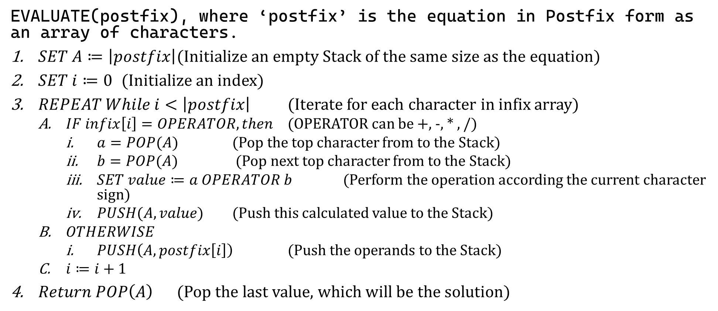
Sample 2
Postfix Evaluation
EVALUATE(postfix), where ‘postfix’ is the equation in Postfix form as an array of characters.
$SET A≔\left|postfix\right|$ (Initialize an empty Stack of the same size as the equation)
$SET i≔0$ (Initialize an index)
$REPEAT While i<\left|postfix\right|$ (Iterate for each character in infix array)
$IF infix\left[i\right]=OPERATOR, then$ (OPERATOR can be +, -, * , /)
$a=POP(A)$ (Pop the top character from to the Stack)
$b=POP(A)$ (Pop next top character from to the Stack)
$SET value≔a OPERATOR b$ (Perform the operation according the current character sign)
$PUSH(A, value)$ (Push this calculated value to the Stack)
$OTHERWISE$
$PUSH\left(A, postfix\left[i\right]\right)$ (Push the operands to the Stack)
$i≔i+1$
$Return POP\left(A\right)$ (Pop the last value, which will be the solution)

Slide 17
Sample 2
Exercise
Carefully read and analyze the Pseudocodes to convert Infix notation into Postfix and evaluating the Postfix notation.
Write the Pseudocodes to:
Convert Infix notation into Polish (prefix) notation.
Evaluate Polish notation.

Slide 18



THANK YOU
Owais Hussain
+92 345-3174270
owais.hussain@kiet.edu.pk
https://www.researchgate.net/profile/Owais-Hussain-3

